Slide 1
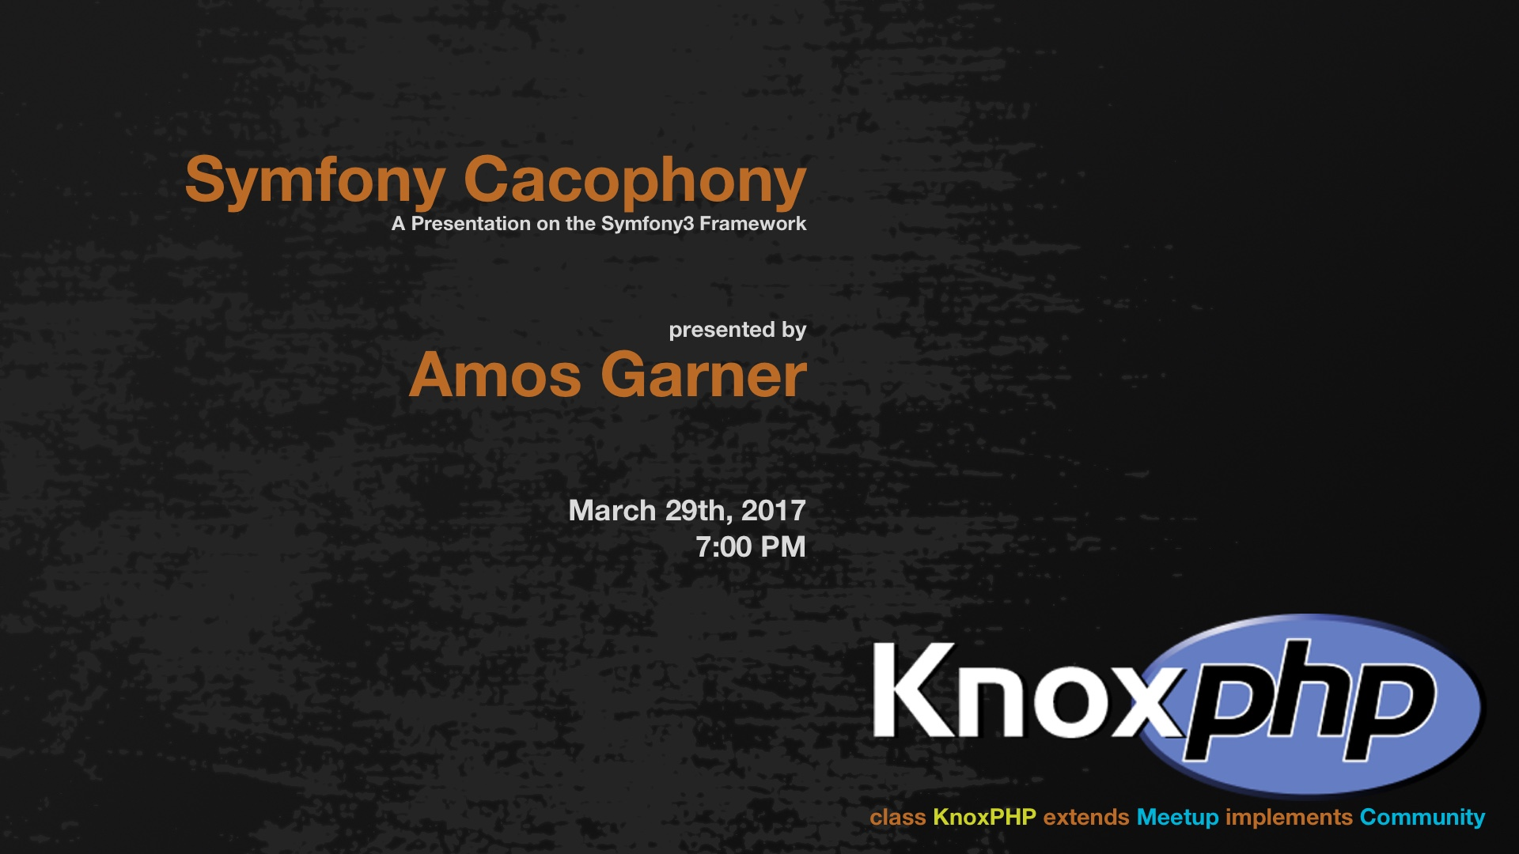

Slide 2
Symfony Cacophony
A Presentation on The Symfony3 Framework

Slide 3

Who am I?
Software Developer
Currently employed at Radio Systems Corporation
B.S. Degree in Information Tech. w/ Focus on Software Dev.
Owner of my own Video Game Prod. Studio
Wrote my first line of code in the fall of 2007
I am not an expert!!
Notes:
Software Dev. That writes code for web and desktop platform.

Slide 4
What am I talking about today?
Discussing the Symfony 3 Framework
File System
Components
Bundles & Services
Demo web app written in Symfony
Code Walkthrough / Debugging
Some best and not so best practices
Quiz Time!!
Final thoughts, opinions, and general filibustering

Slide 5
Why did I do this?
Symfony is a popular framework
Our Company considered Sylius (built on Symf.)
20% Innovation Time provided by RSC
Prev. Exp. With Code Ignitor (Similar Framework)
Personal / Professional Growth
Break out of my Comfort Zone!!
Notes:
Before RSC I was tasked to use it but turned it down due to difficulty .

Slide 6
Research Portion (The boring part)
Symfony File Structure
Symfony Components
Bundles & Services

Slide 7
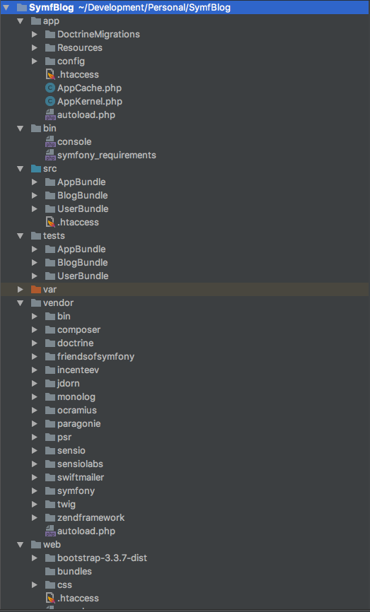
Symfony File Structure
App & Bin
Src
Tests, Var, Web
Vendor

Slide 8
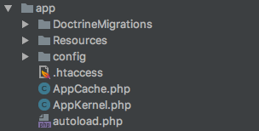
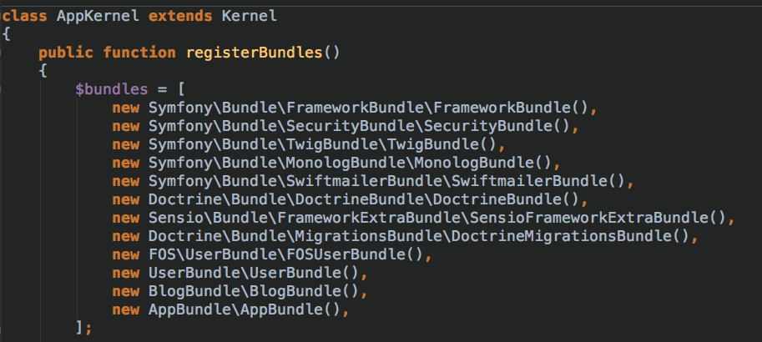
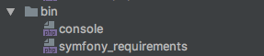
App & Bin Directories
App:
Global Configuration
Global Templates
Translation Files
AppKernal – Bundle Registration ->
Bin:
Symfony’s Console Commands
Cache:Clear
Schema:Update –force
Doctrine:Migrations:Diff

Slide 9
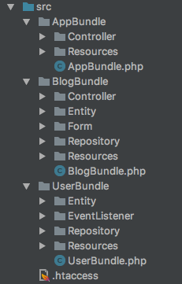
Src Directory
Code written specifically for your app
Default includes AppBundle
Should be organized into Bundles **
Component Placement Conventions
Can be organized into Sub Bundles
Meaning Bundles within Bundles
Notes:
App Bundle: Application Specific One off feature never to be used anywhere else but in one place.

Slide 10
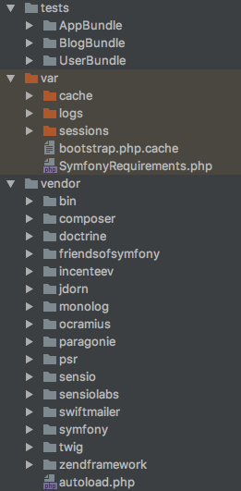
Tests, Var, & Vendor Directories
Tests:
Unit tests
Generated on Bundle Creation
Var:
Cached Code files
Enviorment Logs
Application Session Logs

Slide 11
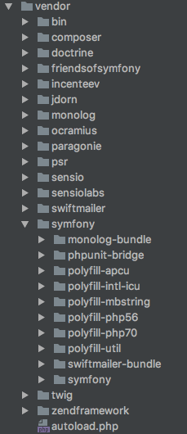
Vendor Directory
Built in Bundles
Code Written by 3rd Party or Framework Provider
Should be Extended if manipulated
NEVER CODE IN THESE FILES!!!
Composer Installed and Updated
Key Advantages:
Feature Separated
Extendable
Testable
Notes:
Composer.js file dependecy documentation

Slide 12
Symfony Components
Symfony CLI Tools
Bundles
Actions & Controllers
Models & Views
Twig Templating Engine
Routing
Configuration (Yet another markup language!!)

Slide 13
Symfony CLI Tools
CLI: Command Line Interface
Comes built into Symfony
Commands found in /bin dir.
Common Uses:
Cache clearing
Bundle Generation
Database creation, migration, and deletion
Schema Update
Notes:
Can anyone tell me why we might want to clear the cache?
Solution: Application changes may not appear if the cache is intact.
CLI Tools Image
List CLI Tools command

Slide 14
Bundles
Everything in Symfony is a Bundle
Bundle = Feature
Must be registered in AppKernel
Natural Habitats:
App, Src, and Vendor Directories
AppBundle is for one-off Bundles**
Non reusable features
Developers Choice
Notes:
Change to One-Off Feautes

Slide 15
Controllers & Actions
Model View Controller (1)
Model: DDL, DML, DCL
View: Page Rendering
Controller: Application Logic / Business Rules
Controllers
/Controller
Wrapper for actions
Feature Specific Actions
Base Functions (2)
Actions
Action: Function inside a controller
Where the magic happens
Must return a Response!!
HTML & JSON
[Function]Action (Ex: IndexAction)
Notes:
(1)
Who has ever used an MVC Before?
Pick someone: Can you tell me an advantage of the MVC Paradigm?
MVC is the separation of model, view and controller — nothing more, nothing less. It's simply a paradigm; an ideal that you should have in the back of your mind when designing classes. Avoid mixing code from the three categories into one class.
This separation of responsibilities allows flexibility down the road. For example, because the view doesn't care about the underlying model, supporting multiple file formats is easier: just add a model subclass for each.
(2)
Computational functions designed to keep action function clean and free of cluttered code.
Ex: Validation, Data Retrieval, Generate Response

Slide 16
Models & Views
Models
Data Objects
PHP Class Files in /Entity dir.
Doctrine Entity Manager
Configurable
Repositories:
Default Repos.
FindOne, FindAll, FindBy, FindOneBy
Custom Repos.
/Repository
Specific Queries
Views
Page Rendering
Twig Templating Engine
Get data from controller function
Display data
Minimum logic
Notes:
Specific queries are good for offloading operations to the SQL server. This is also used to retrieve refined data instead of unnecessary object data.
Q: What are some reasons I wouldn’t want all the object data being returned in a db request?
A: Efficiency, Security

Slide 17

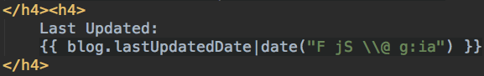
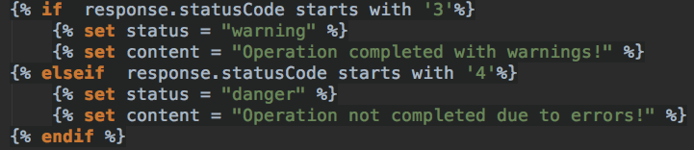
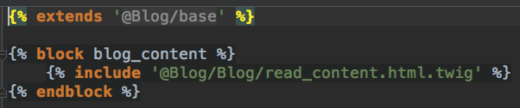
Twig Templating Engine
Functions:
Declared with: {{ }}
Filters:
Declared with: {{ | }}
Logic:
Declared with: {% %}
Blocks & Inheritance:
Block: Segment of a template
Extends: Calls in parent template
Notes:
Q: Can anyone tell me what a 400 Status code means?
A; Somethings broke in particular it means the resource requested is not found.

Slide 18
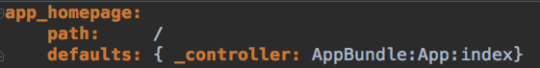
Routing
Found: Bundle/Resources/config/routing.yml (1)
Configuration for telling Symfony how to route urls to actions
Ex:
User Requests: http://symfblog.dev/
Symfony Looks for a route matching the path: /
This route lives in the AppBundle config routing file.
The route name app_homepage is globally unique
Routes can be generated in a view using:
{{ path(’global_route_name') }}
Notes:
YAML is a human readable data serialization language. Commonly used for config files.
Will discuss further on in the configuration section.

Slide 19
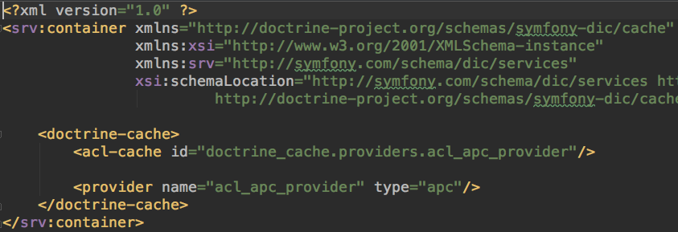
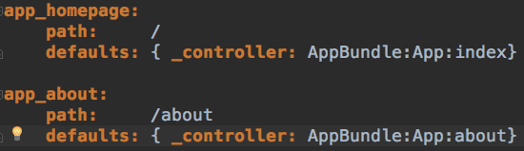
Symfony Configuration Types
Configuration Options: YML, XML. Annotation
YML
Annotation
XML

Slide 20
Symfony Bundles & Services

Slide 21
Bundles
AppBundle
Src Bundles
Vendor Bundles
One Off Features
Ex:
Home & About
Feature Bundles
Separated from Core App
Multiple Uses
Ex:
Blog Operations
Provided By Symfony
3rd party
Installed w/ Composer
Updated w/ Composer
Extended for customization

Slide 22
Services
Symfony Services
PHP object for global task
Dependency Injectable
Configurable
EX:
Web Mail Service
services.yml
Configuration for services
I used this to tap into symfony events

Slide 23
Application Demo & Code Walkthrough
Before we begin lets take a quick break.
SymfBlog:
Blogging platform for multiple users
User Account Editing
Blog CRUD Operations
User Login Logging for Auditing

Slide 24
What I Liked:
Bundles, Bundles, and more Bundles
Doctrine’s Entity Management System
Symfony's File System Structure

Slide 25
What I Had Trouble With:
Drowning in a sea of config files
Tapping into Symfony's Event System
Keeping Bundle Specific Code

Slide 26
What I Didn’t Like:
Setting Up a Dev. Environment
Configuring Environments Altogether

Slide 27
Final Thoughts:
Strong and Flexible Framework
Steep Learning Curve, but rewarding
Documentation is awesome
Would recommend to fellow devs, but not as a first framework.

Slide 28
Recommendations :
Symfony Plugin is a must have
https://plugins.jetbrains.com/plugin/7219-symfony-plugin
Phpstorm is a fantastic IDE
Valet for local dev environment
Xdebug for debugging

Slide 29
Questions?

Slide 30
Discussion Resources:
Source Files: https://github.com/AmosGarner/SymfBlog

